Slide 1
Windows Artifacts Forensic

Slide 2
Objective
By the end of this module, participants will be able to analyze artifacts common to windows 7 operating system.
Notes:
By the end of this module, participants will be able to analyze artifacts common to the Windows 7 operating system

Slide 3
What is an Operating System ?

Slide 4




What Is an Operating System?
The largest and most important application
An interface between applications, hardware, and users
Support for many hardware configurations
Notes:
The largest and most important application
An interface between applications, hardware, and users
Support for many hardware configurations

Slide 5

Windows Operating System
Microsoft Windows is the most prevalent and widely used operating system
Examiners must be aware of how Windows is used and where pertinent artifacts could be stored
Notes:
Microsoft Windows is the most prevalent and widely used operating system
Examiners must be aware of how Windows is used and where pertinent artifacts could be stored

Slide 6
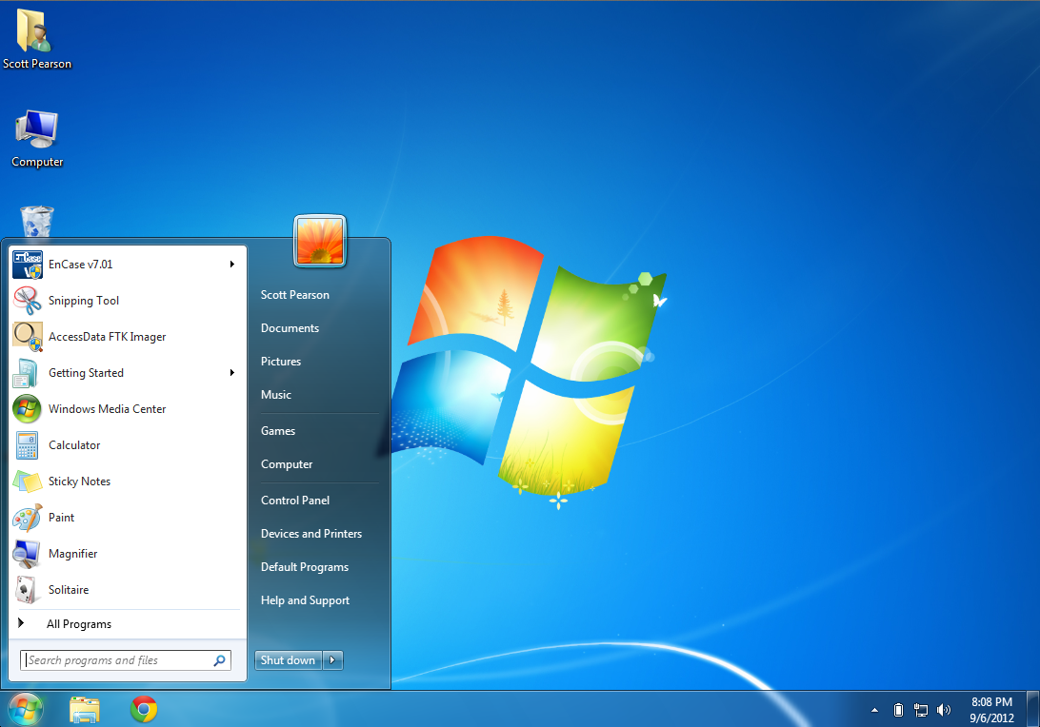
Windows 7 Desktop

Slide 7
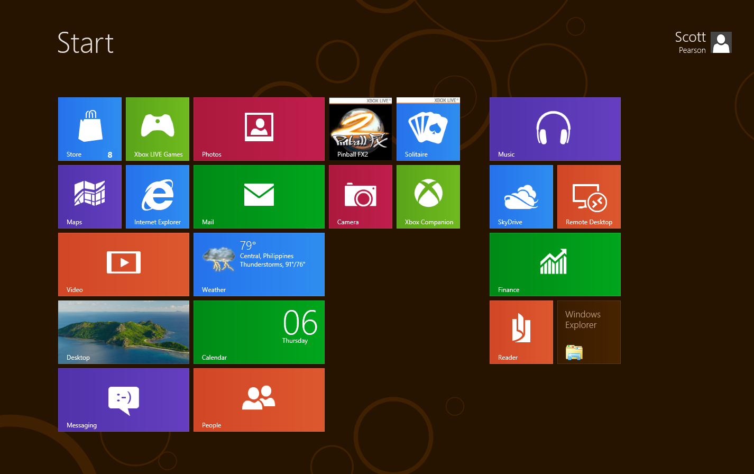
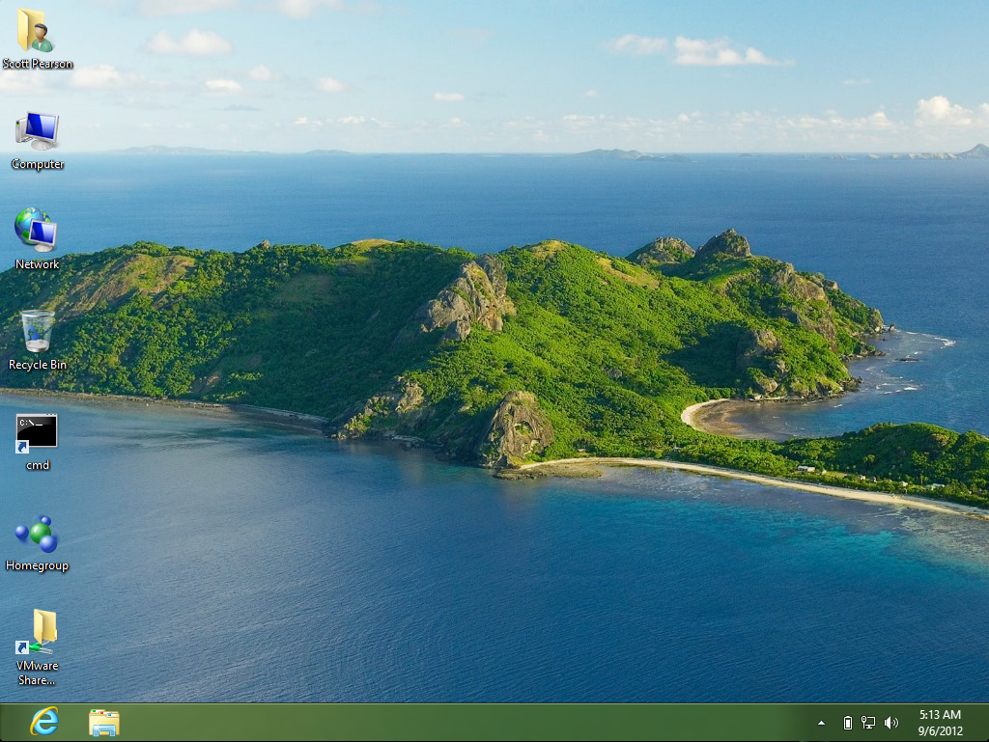
Windows 8 Desktop

Slide 8
Common Windows Artifacts

Slide 9


Windows Event Logs
An event is a notable incident that generates a log entry or user notification
An event log:
Is a collection of events categorized by function
Provides a historical reference
C:/Windows/System32/Winevt/Logs
Notes:
An event is a notable incident that generates a log entry or user notification
An event log:
Is a collection of events categorized by function
Provides a historical reference
Windows Logs
The Windows Logs category includes the logs that were available on previous versions of Windows: the Application, Security, and System logs. It also includes two new logs: the Setup log and the ForwardedEvents log. Windows logs are intended to store events from legacy applications and events that apply to the entire system.
Application log
The Application log contains events logged by applications or programs. For example, a database program might record a file error in the application log. Program developers decide which events to log.
Security log
The Security log contains events such as valid and invalid logon attempts, as well as events related to resource use, such as creating, opening, or deleting files or other objects. Administrators can specify what events are recorded in the security log. For example, if you have enabled logon auditing, attempts to log on to the system are recorded in the security log.
Setup log
The Setup log contains events related to application setup.
System log
The System log contains events logged by Windows system components. For example, the failure of a driver or other system component to load during startup is recorded in the system log. The event types logged by system components are predetermined by Windows.
ForwardedEvents log
The ForwardedEvents log is used to store events collected from remote computers. To collect events from remote computers, you must create an event subscription

Slide 10
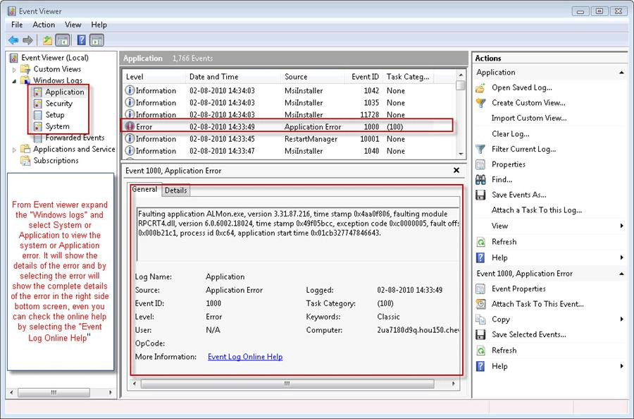
Windows Event Logs

Slide 11

Windows User Profile
The user profile is a default collection of folders to store user-generated data
Every user with a Windows account has their own user profile
Windows 7 location → C:\Users\<UserID>
Notes:
The user profile is a default collection of folders to store user-generated data
Every user with a Windows account has their own user profile
Windows 7 location → C:\Users\<UserID>

Slide 12
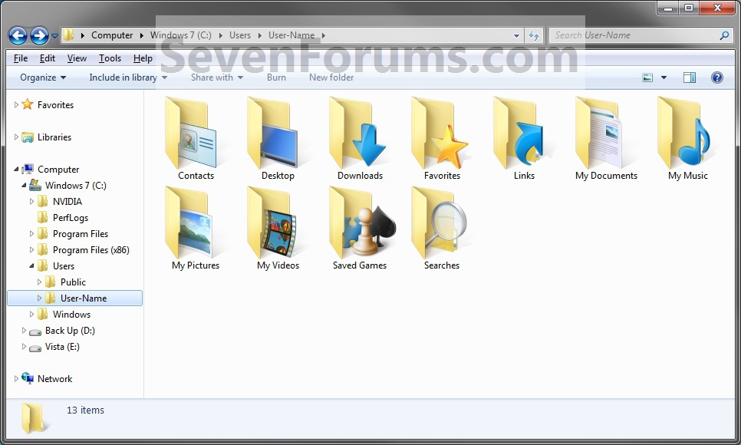
Windows User Profile

Slide 13

Temporary Internet Files
Serves as the browser cache,
Cache pages and other multimedia content, such as video and audio files, from websites visited by the user.
This allows websites to load more quickly the next time they are visited.
%userprofile%\AppData\Local\Microsoft\Windows\Temporary Internet Files
Notes:
In Windows 7, this “Temporary Internet Files” folder is located at
%userprofile%\AppData\Local\Microsoft\Windows folder.
It’s also a hidden folder that won’t show up if “Hide protected operating system files” option is checked.
Dig one step deeper, there are actually more folders inside this Temporary Internet Files folder. However, you will have to type the folder name in Explorer address box in order to accessing them.
%userprofile%\AppData\Local\Microsoft\Windows\Temporary Internet Files\Content.IE5
And that’s the folder that stores all files that you open directly from your Internet Explorer.
Temporary Internet Files is a folder on Microsoft Windows which serves as the browser cache for Internet Explorer to cache pages and other multimedia content, such as video and audio files, from websites visited by the user. This allows such websites to load more quickly the next time they are visited.
Overview
Each time a user visits a website using Microsoft Internet Explorer, files downloaded with each web page (including HTML and Javascript code) are saved to the Temporary Internet Files folder, creating a web cache of the web page on the local computer's hard disk drive, or other form of digital data storage. The next time the user visits the cached website, only changed content needs to be downloaded from the Internet; the unchanged data is available in the cache.
Despite the name 'temporary', the cache of a website remains stored on the hard disk until the user manually clears the cache, the cache expires or if the cache is full. This is often regarded as a privacy issue [1] [2], because anyone with access to the computer can view the cache. The contents of the folder are indexed using an index.dat file, a form of database.
The Temporary Internet Files cache can be useful in certain situations. For example, if no Internet connection is available, previously cached websites are still available offline. Certain online media files (such as embedded Flash movies) are not easily accessed directly through Internet Explorer, but are automatically saved into the cache after viewing them. Depending on the type of website and how often it is updated, the cached data may not reflect the online version of the website. The cache is also useful for police to collect forensic evidence.

Slide 14
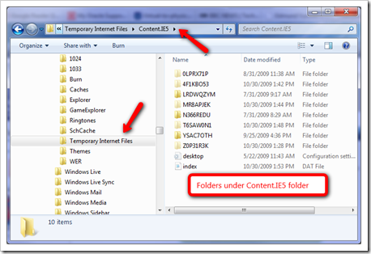
Temporary Internet Files

Slide 15
Recent Items Folder and Link Files
Recent Items;
The Recent Items folder is used by Windows to record what documents have been opened.
Link Files:
Is a shortcut to a file stored within the file system
Provides quick access to commonly used files
May contain valuable clues to the actual location and/or prior existence of files on the computer
Notes:
A link file:
Is a shortcut to a file stored within the file system
Provides quick access to commonly used files
May contain valuable clues to the actual location and/or prior existence of files on the computer
Most Recent Folder
The Recent Items folder (previously called Recent Documents in Windows XP) is used by Windows to record what documents have been opened. The list is displayed in the Windows start menu either under the ‘Recent Items’ menu item or when you hover over applications.
The following path is where the folder is stored. By accessing it from the folder you can access more history, sort by date and see the file types (by looking at the file icons).
C:\Users\%UserName%\AppData\Roaming\Microsoft\Windows\Recent

Slide 16
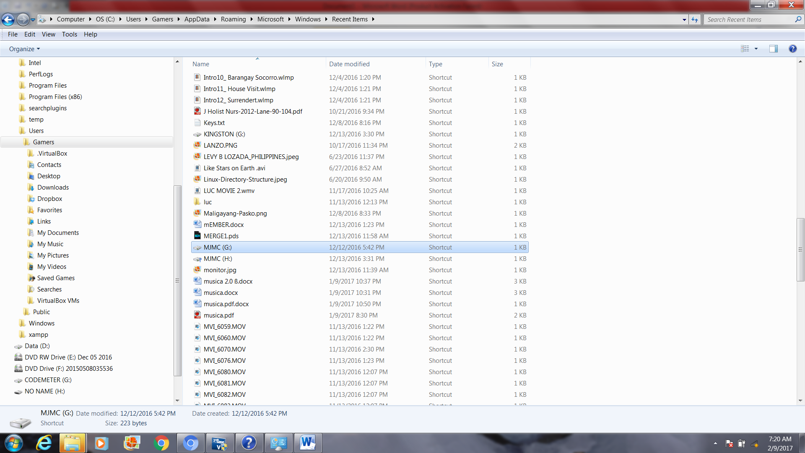
Recent Items Folder and Link Files
Notes:
The Key Artifacts That Need to be Found When Investigating LNK Files
LNK files typically contain the following items of evidentiary value:
- The original path of the file
- MAC times of the original file; not only will a LNK file contain timestamps for the LNK file itself, it will also contain MAC times for the linked file within its metadata as well
Information about the volume and system where the LNK file is stored. This will include volume name, serial number, NetBIOS name, and MAC address of the host where the linked file is stored
- Network details if the file was stored on a network share or remote computer
- File size of the linked file
FO 28
LE 24
Last accessed
File Created
Last written

Slide 17

Recycle Bin
Is temporary storage for deleted files
Will not contain files deleted from devices with removable storage
Is unique to every Windows user
\$Recycle.Bin\%SID%,
- %SID% is the SID of the user that performed the deletion.
Notes:
Recycle Bin is located in a hidden directory named
\$Recycle.Bin\%SID%, where %SID% is the SID of the user that performed the deletion. Secondly,
when files are moved into the Recycle Bin, the original file is renamed to $R followed by a set of random
characters, but maintaining the original file extension.
At the same time a new file beginning with $I followed by the same set of random characters given to the $R file and the same extension, is created; this
file contains the the original filename/path, original file size, and the date and time that the file was moved
to the Recycle Bin. You’ll also notice at all of the $I files are exactly 544 bytes long.
do this), or you can simply open the file up in a hex editor. The file is structured as follows:
Bytes 0-7: $I File header – always set to 01 followed by seven sets of 00.
Bytes 8-15: Original file size – stored in hex, in little-endian.
Bytes 16-23: Deleted date/time stamp – represented in number of seconds since Midnight, January 1,
1601. Use a program such as Decode to assist with figuring out the exact date/time, if you don’t want

Slide 18
Recycle Bin
Recycle bin files can:
Be restored to their original file system location
Be emptied from the file system
Provide clues about files the user tried to remove
\$Recycle.Bin\%SID%,
- %SID% is the SID of the user that performed the deletion.
Notes:
Recycle Bin is located in a hidden directory named
\$Recycle.Bin\%SID%, where %SID% is the SID of the user that performed the deletion. Secondly,
when files are moved into the Recycle Bin, the original file is renamed to $R followed by a set of random
characters, but maintaining the original file extension.
At the same time a new file beginning with $I followed by the same set of random characters given to the $R file and the same extension, is created; this
file contains the the original filename/path, original file size, and the date and time that the file was moved
to the Recycle Bin. You’ll also notice at all of the $I files are exactly 544 bytes long.
do this), or you can simply open the file up in a hex editor. The file is structured as follows:
Bytes 0-7: $I File header – always set to 01 followed by seven sets of 00.
Bytes 8-15: Original file size – stored in hex, in little-endian.
Bytes 16-23: Deleted date/time stamp – represented in number of seconds since Midnight, January 1,
1601. Use a program such as Decode to assist with figuring out the exact date/time, if you don’t want

Slide 19
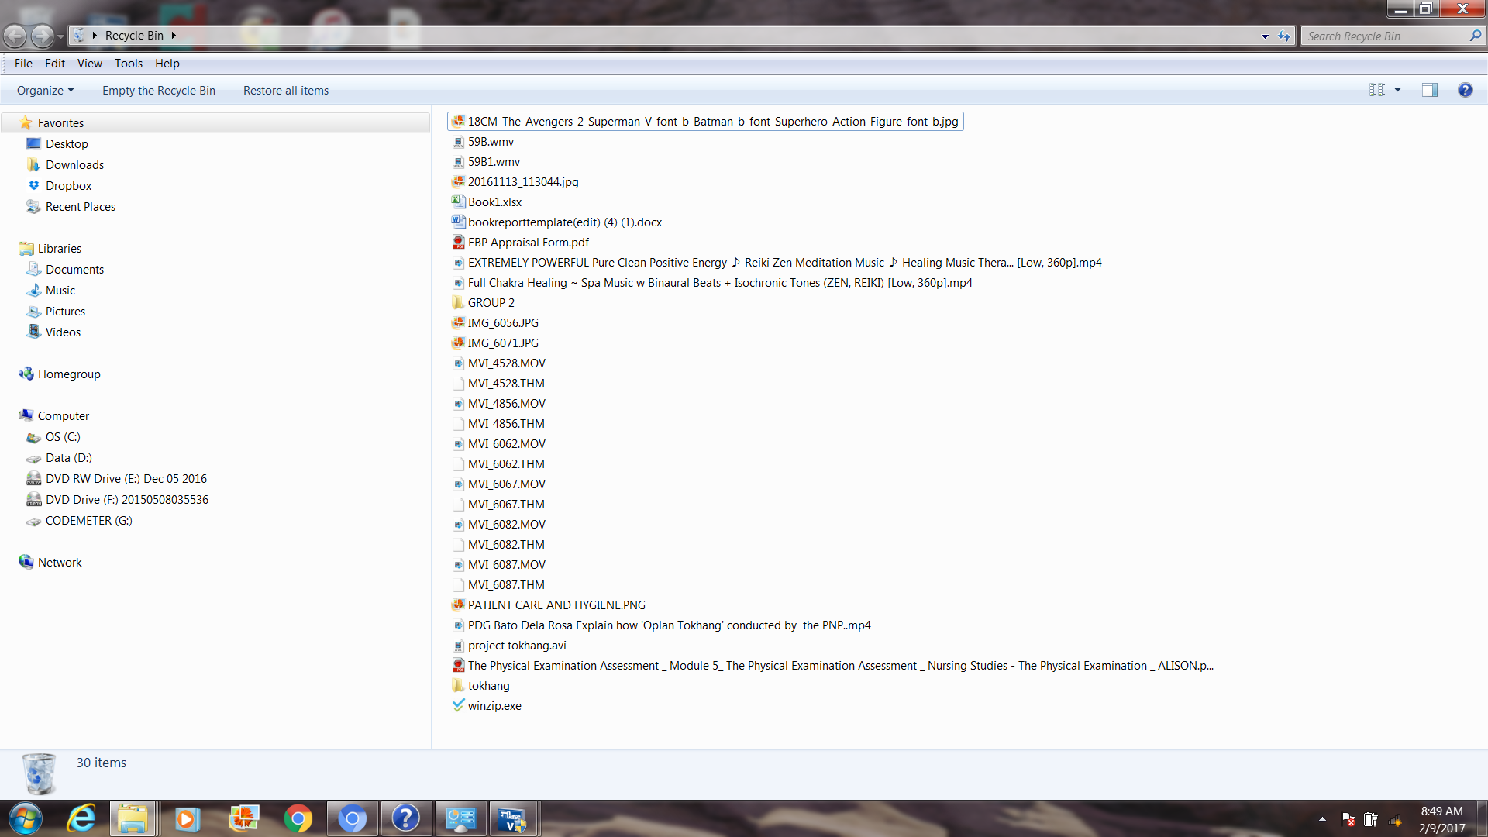
Recycle Bin

Slide 20




Installed Applications
Allow the users to interact with the computer system
Generate specific types of output
Leave unique footprints that can assist the examiner to understand how the system was used

Slide 21
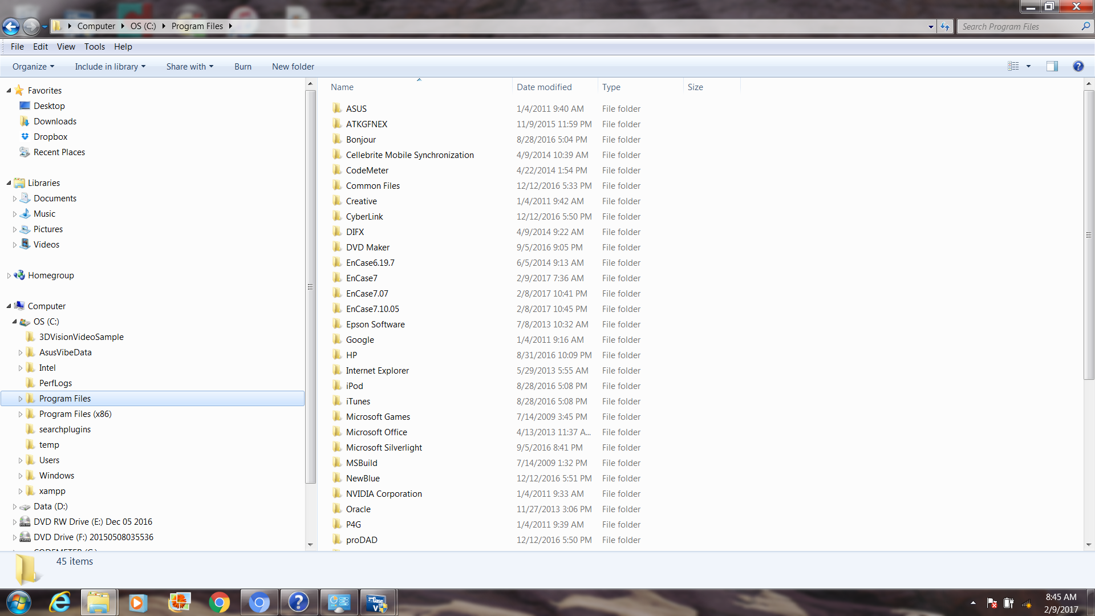
Volume Shadow Copy

Slide 22

Volume Shadow Service (VSS)
Creates a snapshot image of application data on a volume
Enables reliable backups even while the system is actively running
Enables examiners to access previous versions of files
Notes:
Creates a snapshot image of application data on a volume
Enables reliable backups even while the system is actively running
Enables examiners to access previous versions of files
Volume shadow copies are bit level differential backups of a volume.
–16 KB blocks.
–Copy on write.
–Volume Shadow copy files are “difference” files.
•The shadow copy service is enabled by default on Vista and Windows 7, but not on Windows 2008 or 2008 R2.

Slide 23
Volume Shadow Copy
Volume shadow copies are bit level differential backups of a volume.
–16 KB blocks.
–Copy on write.
–Volume Shadow copy files are “difference” files.
Notes:
Creates a snapshot image of application data on a volume
Enables reliable backups even while the system is actively running
Enables examiners to access previous versions of files
Volume shadow copies are bit level differential backups of a volume.
–16 KB blocks.
–Copy on write.
–Volume Shadow copy files are “difference” files.
•The shadow copy service is enabled by default on Vista and Windows 7, but not on Windows 2008 or 2008 R2.

Slide 24
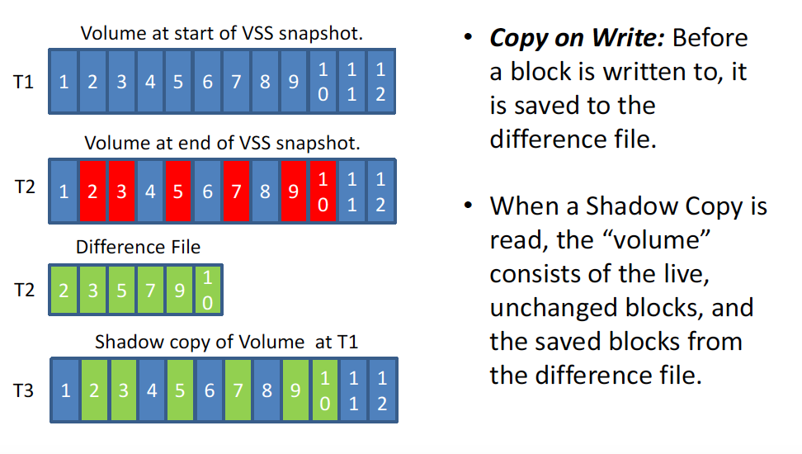
Volume Shadow Copy
Notes:
Before a block is written to with a new data, the old data will be saved to the differential file (vsc file). When the shadow copy is read (vsc file), the volume now consist of the live, unchanged blocks and the saved blocks from the differential file( vsc file)

Slide 25
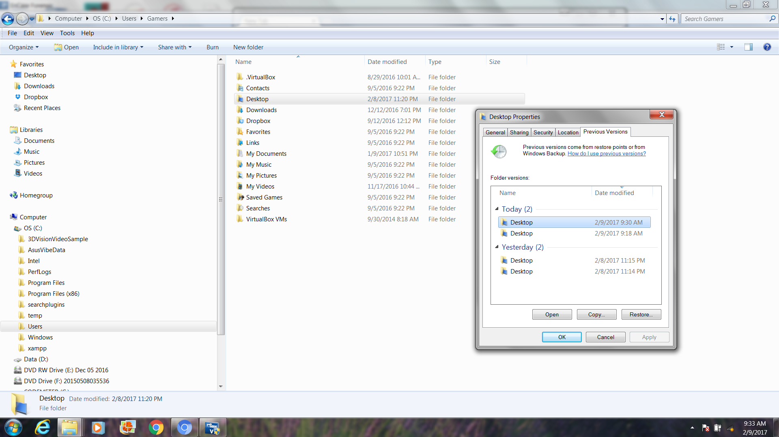
Volume Shadow Copy

Slide 26
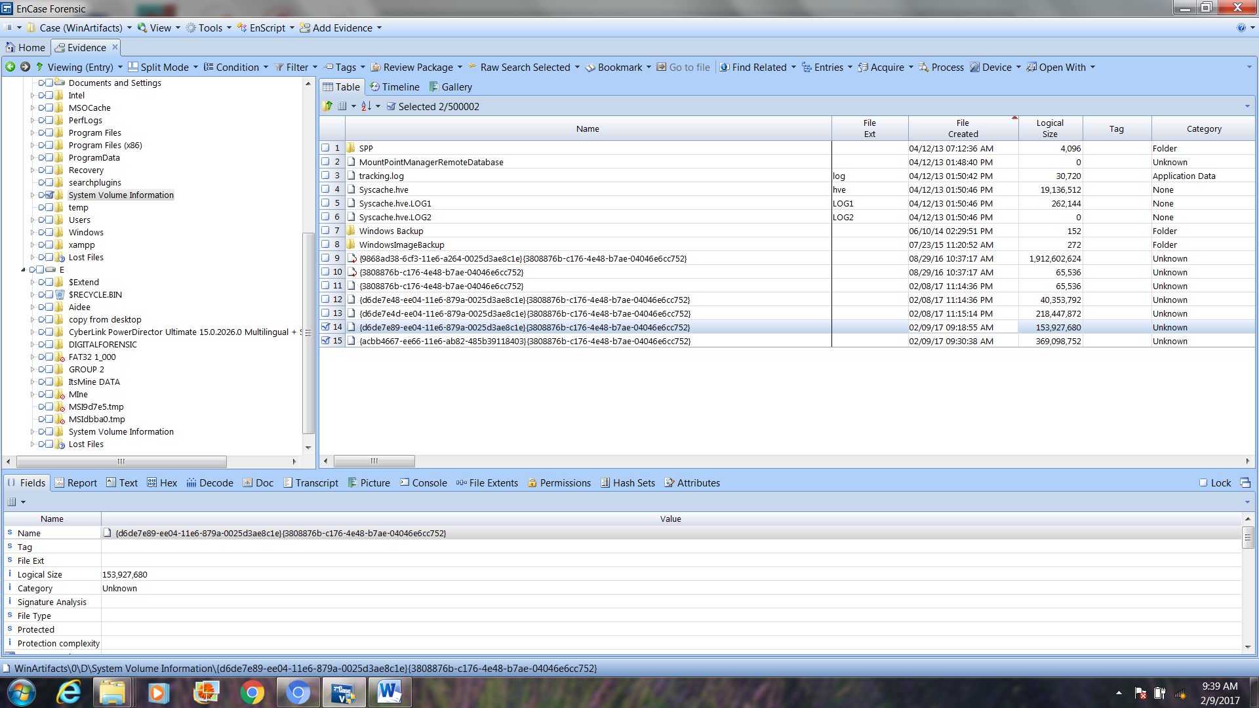
Volume Shadow Copy

Slide 27
Windows Prefetch
Boosts performance by preloading data into RAM based on cache history
Provides clues about frequently-used applications and when they were last used
Location = C:\Windows\Prefetch
.PF extension
NTOSBOOT-B00DFAAD.PF
Notes:
Each time the computer starts, the prefetcher portion of the memory manager in Windows references the prefetch folder to learn about previous startup activities and the applications that were used. By caching the details of previous successful startups in the prefetch folder, Windows can accelerate subsequent startups and improve startup performance.
Prefetching is beneficial to the Windows operating system because a typical Windows startup involves a multitude of files that often must be opened multiple times. This multiple-access behavior can take considerable time and slow the boot-up process.
Prefetching traces the system startup activity and creates a record of just what instructions and data are accessed. Future startups can use that trace data to load the instructions and data far more efficiently and speeding the effective system startup.
The prefetch folder is typically stored within the Windows System folder (\Windows\Prefetch) and trace files always include a .PF extension (for “PreFetch”). The prefetch folder will contain at least one boot trace file called NTOSBOOT-B00DFAAD.PF along with additional trace files for each application. The prefetch files for applications are generally amalgams of the application name and a hash code. For example, the prefetch file for Adobe Acrobat Reader may be named ACRORD32.EXE-1CE22EA3.PF.
Windows maintains the prefetch folder automatically, and no direct intervention is required from IT administrators or individual computer users. It is generally not recommended to empty the prefetch folder manually. This will not damage the OS, but it will force Windows to re-create the prefetch files for the operating system and applications -- actually slowing the system's apparent performance until the .PF files are recreated.

Slide 28
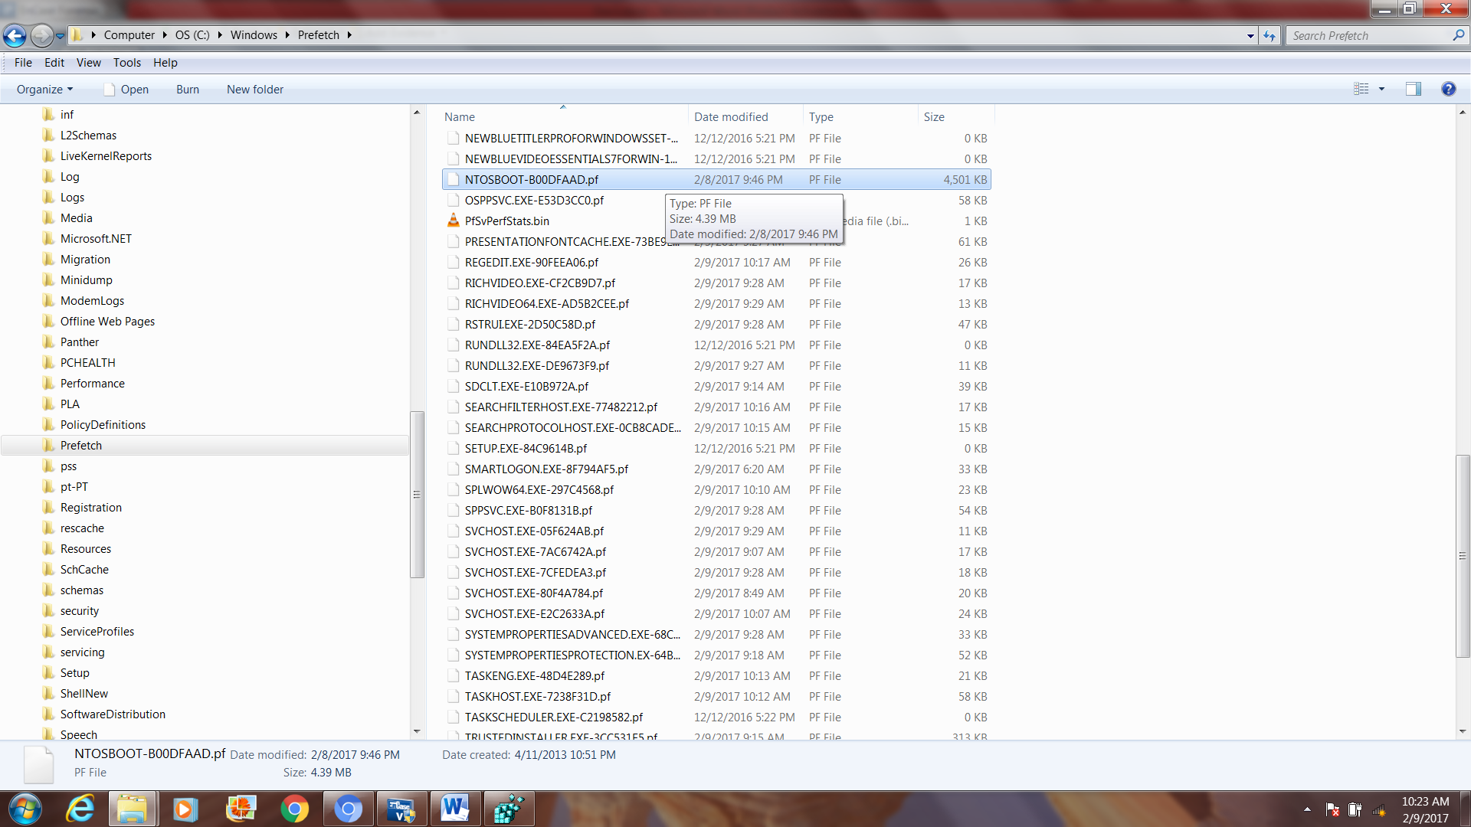
Windows Prefetch

Slide 29
Windows Registry
Is a database of operating system, installed application, and user configuration settings
Provides valuable clues about how the computer system was used since installation time
The location of these registry hives are as follows:
HKEY_LOCAL_MACHINE \SYSTEM : \system32\config\system HKEY_LOCAL_MACHINE \SAM : \system32\config\sam HKEY_LOCAL_MACHINE \SECURITY : \system32\config\security HKEY_LOCAL_MACHINE \SOFTWARE : \system32\config\software
HKEY_USERS \UserProfile : \winnt\profiles\username HKEY_USERS.DEFAULT : \system32\config\default
Notes:
Is a database of operating system, installed application, and user configuration settings
Provides valuable clues about how the computer system was used since installation time
Location of Windows registry files
The location of these registry hives are as follows:
HKEY_LOCAL_MACHINE \SYSTEM : \system32\config\system HKEY_LOCAL_MACHINE \SAM : \system32\config\sam HKEY_LOCAL_MACHINE \SECURITY : \system32\config\security HKEY_LOCAL_MACHINE \SOFTWARE : \system32\config\software
HKEY_USERS \UserProfile : \winnt\profiles\username HKEY_USERS.DEFAULT : \system32\config\default
User profile hives can be found in the HKEY_USERS key and they store specific registry data that is related to the user’s application settings, desktop, and environment as well as holding data related to his/her printer(s) and network connections
Some hives are volatile and don’t have associated files. The system creates and manages these hives entirely in memory; the hives are therefore temporary in nature. The system creates volatile hives every time the system boots. Examples are:
HKEY_LOCAL_MACHINE \HARDWARE : Volatile hive HKEY_LOCAL_MACHINE \SYSTEM \Clone : Volatile hive
These files are database files, and only RegEdit, Regedit32 and the Kernel32 can read them. The primary tool in Windows 10/8/7 for working directly with the registry is Registry Editor. To access it, simply type Regedit in Start Menu Search Bar and hit Enter !
The Windows registry is an invaluable source of forensic artifacts for all examiners and analysts. The registry holds configurations for Windows and is a substitute for the .INI files in Windows 3.1. It is a binary, hierarchical database and some of its contents include configuration settings and data for the OS and for the different applications relying on it. The registry not only keeps records of OS and application settings but it also monitors and records user-specific data in order to structure and enhance the user’s experience during interactions with the system. Most of the time users do not interact with the registry in a straightforward manner, but they interact indirectly with it via installation routines, applications, and programs, such as Microsoft Installer files. Nonetheless, system admins have the capability of interacting directly with the registry via regedit.exe (the registry editor) that comes with all varieties of Windows.
HKEY_CLASSES_ROOT – storage for information about registered programs and file associations.
HKEY_CURRENT_USER – storage for settings specific to the current user. If your computer is set up with multiple user accounts this is where the settings for each user are kept.
HKEY_LOCAL_MACHINE – storage for settings that apply to all users of the computer.
HKEY_USERS – storage for subkeys which correspond to the HKEY_CURRENT_USER keys for each user account.
HKEY_CURRENT CONFIG – storage for keys generated during boot. This hive is actually created when the computer boots and is not stored on your hard drive.
The Windows registry is actually made up of several files named SAM, SOFTWARESECURITY, and SYSTEM (notice no file extension) located in the c:\windows\system32\config folder. There is also a file named NTUSER.DAT, which is located in c:\Documents and Settings\<your user name> for Windows XP and c:\Users\<your user name> for Windows Vista and Windows 7. These files relate to the above hives.
NTUSER.DAT – contains the HKEY_CURRENT_USER hive.
SAM – contains the HKEY_LOCAL_MACHINE\SAM hive.
SECURITY – contains the HKEY_LOCAL_MACHINE\SECURITY hive.
SOFTWARE – contains the HKEY_LOCAL_MACHINE\SOFTWARE hive.
SYSTEM – contains all other sub hives of THE HKEY_LOCAL_MACHINE hive.

Slide 30
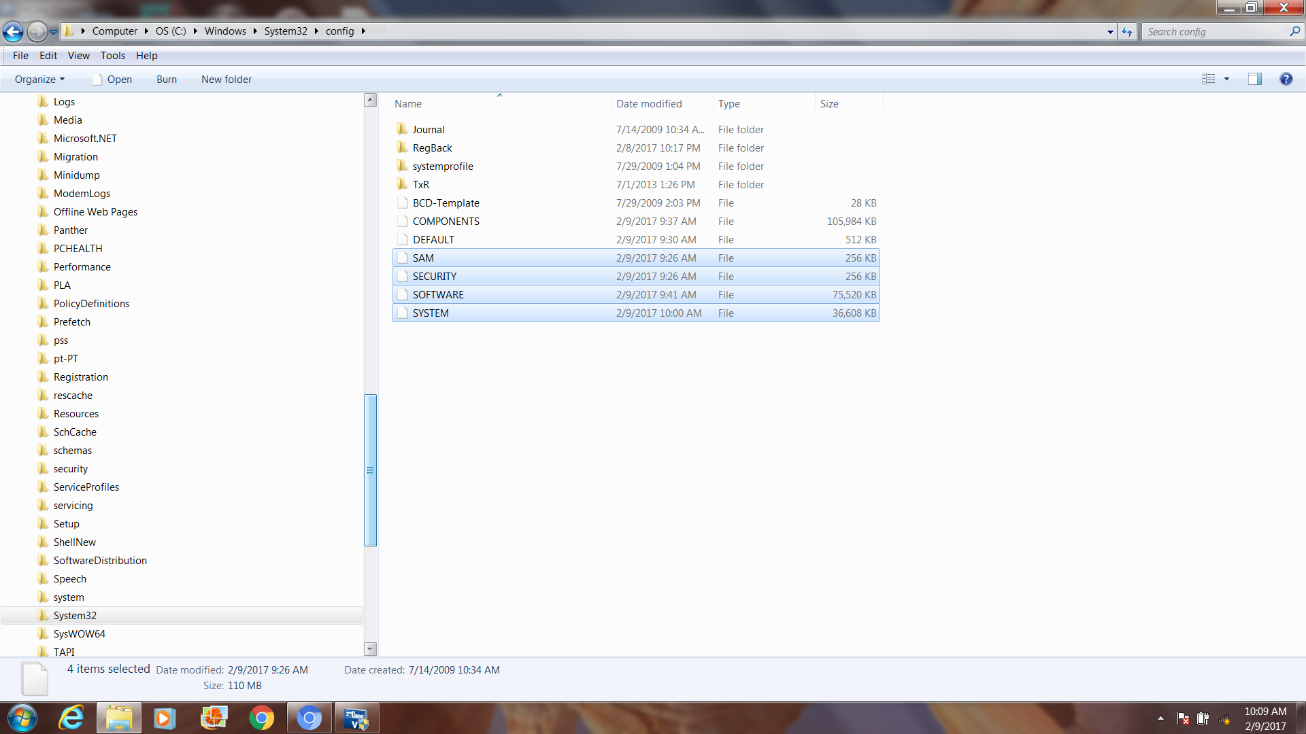
Windows Registry

Slide 31
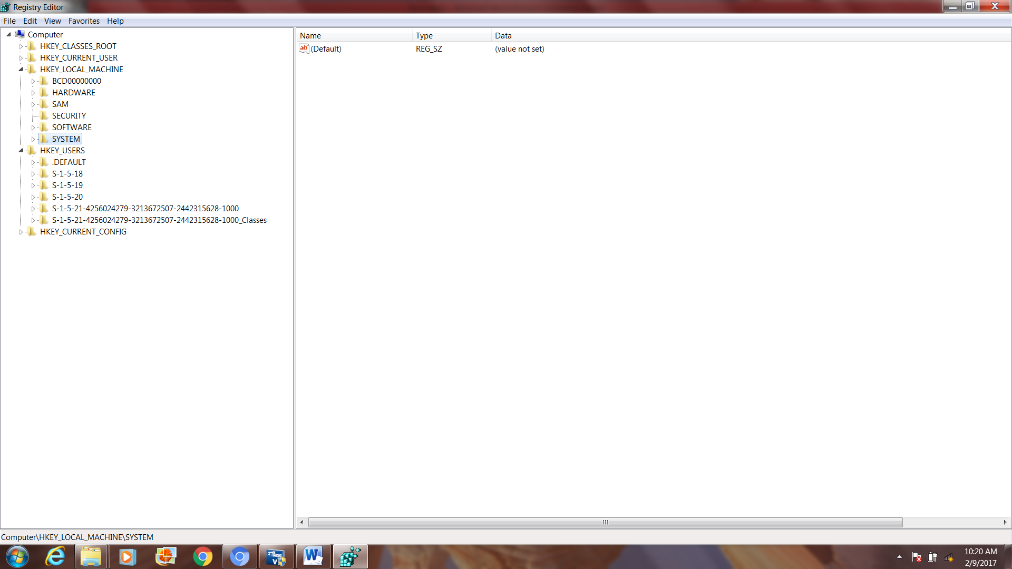
Windows Registry

Slide 32
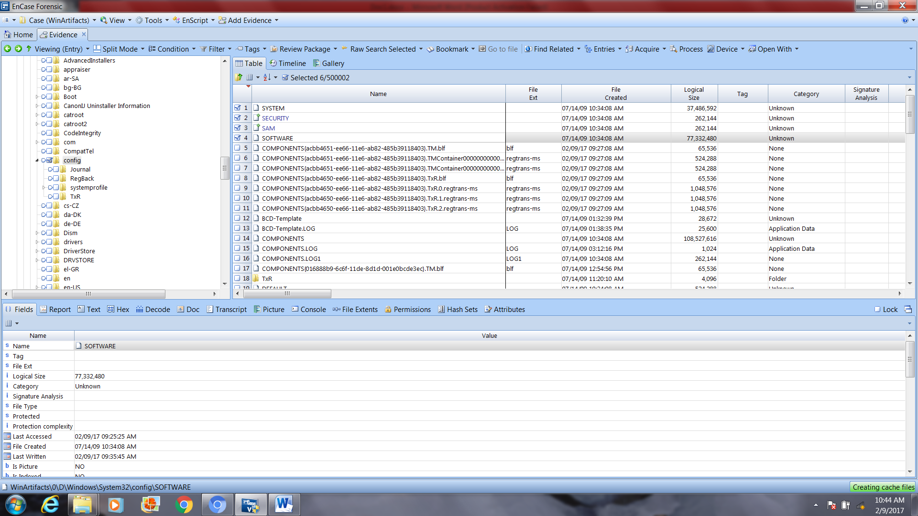
Windows Registry

Slide 33
End
Thank you
and
Good day …

